Slide 1
" fraud detection system for Fastag transactions "
“Leveraging Machine Learning Classification Techniques"

Slide 2
Problem Statement:
This internship project focuses on leveraging machine learning classification techniques to develop an effective fraud detection system for Fastag transactions. The dataset comprises key features such as transaction details, vehicle information, geographical location, and transaction amounts. The goal is to create a robust model that can accurately identify instances of fraudulent activity, ensuring the integrity and security of Fastag transactions.

Slide 3
Introduction
Overview: Briefly introduce the project.
Goal: Develop a robust fraud detection system for Fastag transactions using machine learning.
Importance: Ensuring the integrity and security of Fastag transactions.

Slide 4
To build an effective fraud detection system for Fastag transactions using Python, we will follow these steps:
Data Loading and Exploration
Data Preprocessing
Exploratory Data Analysis (EDA)
Feature Engineering
Model Development and Training
Model Evaluation
Model Interpretation and Insights
Deployment and Real-time Detection
Evaluate the Model

Slide 5
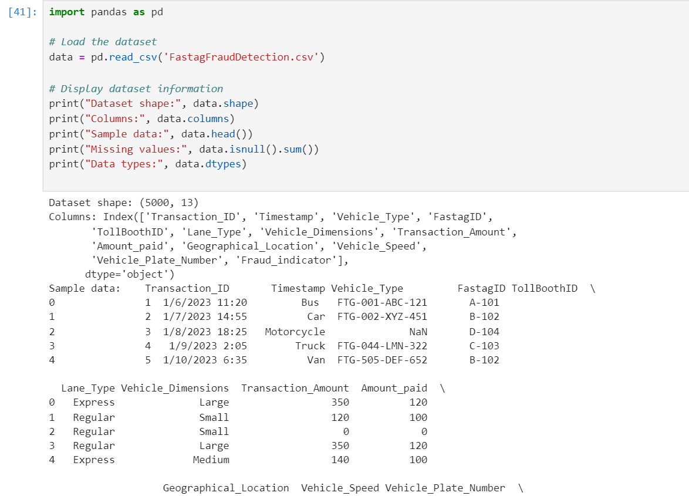
Data Exploration
Load the Dataset: Begin by loading the dataset into a pandas Data Frame to easily manipulate and analyze the data.
Understand the Data Structure: Use basic pandas functions to get an overview of the data, including the data types of each column and basic statistical summaries.

Slide 6
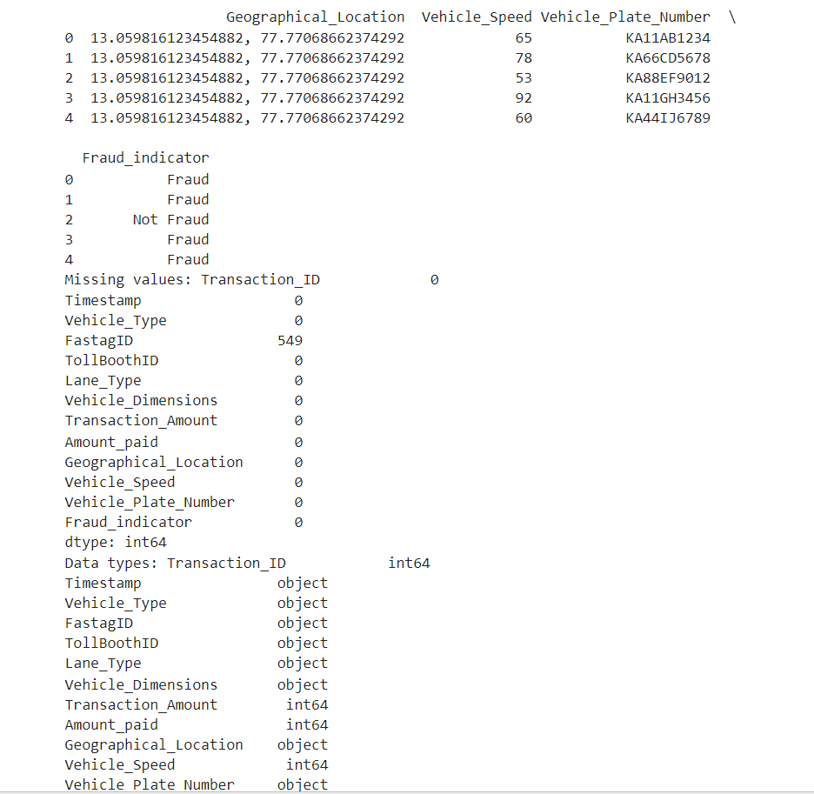

Slide 7
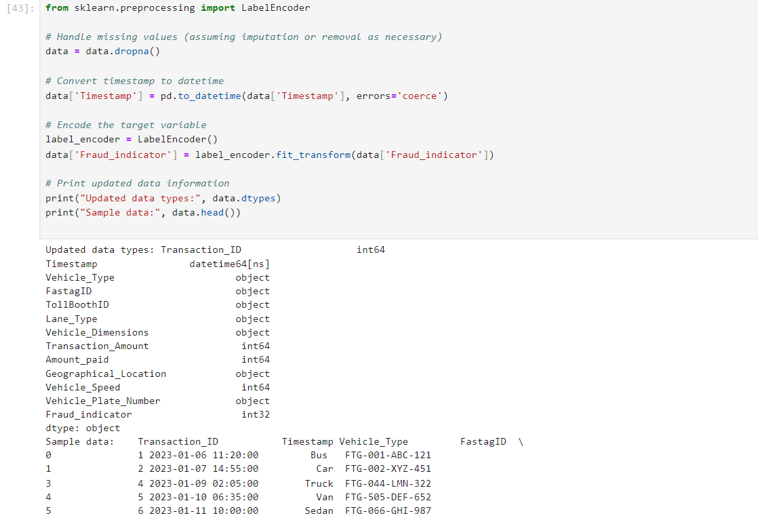
Data Preprocessing
Handle missing values
Convert categorical columns to numerical
Convert timestamps to date time objects
Label encode the target variable

Slide 8
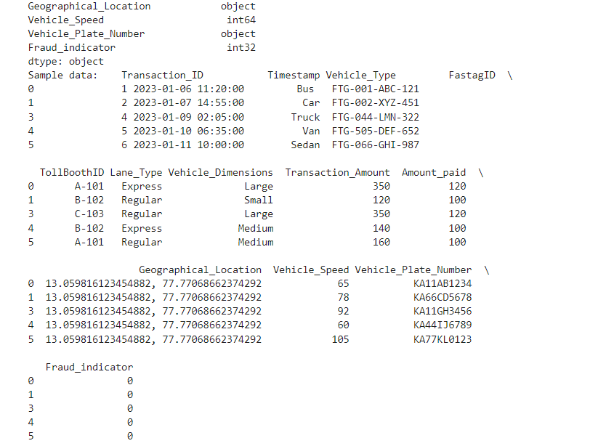

Slide 9
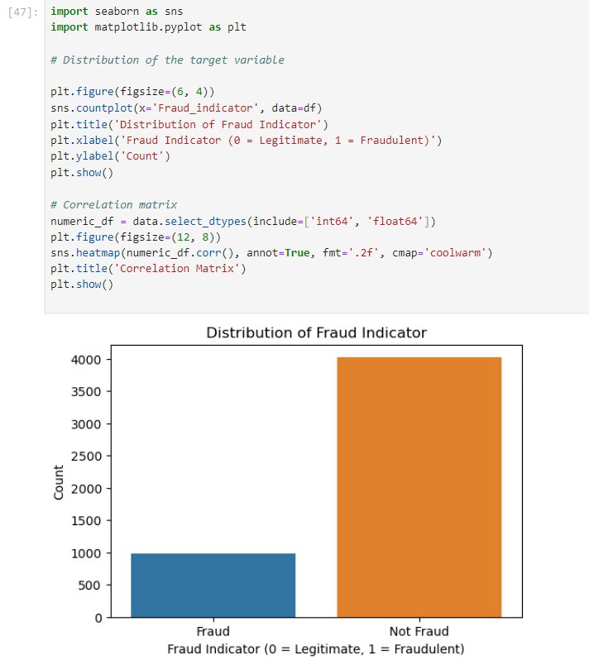
Exploratory Data Analysis (EDA)
Visualize the distribution of the target variable
Correlation matrix for numerical features python

Slide 10
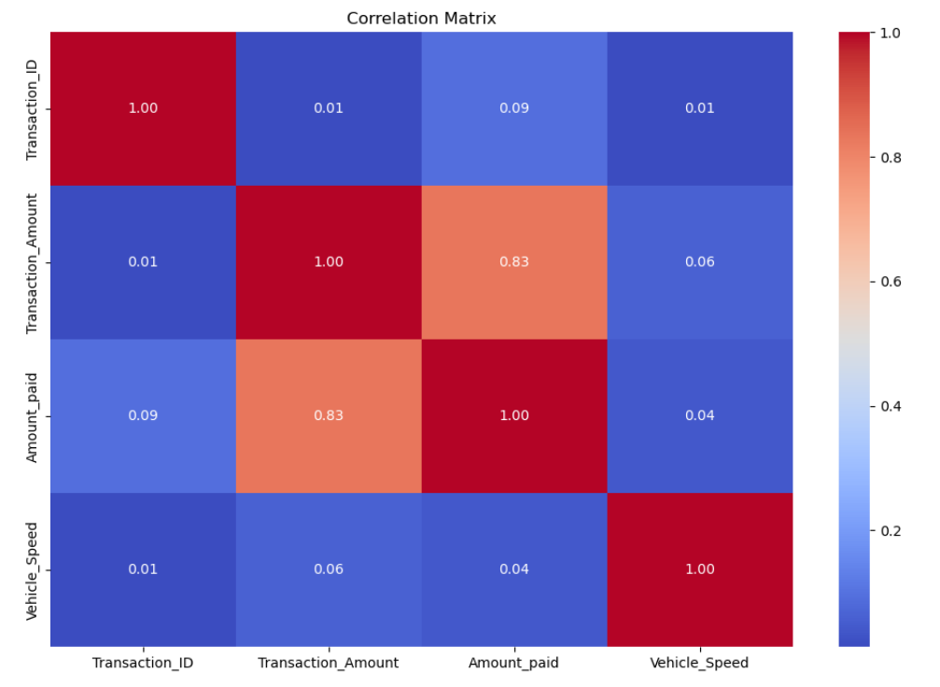

Slide 11
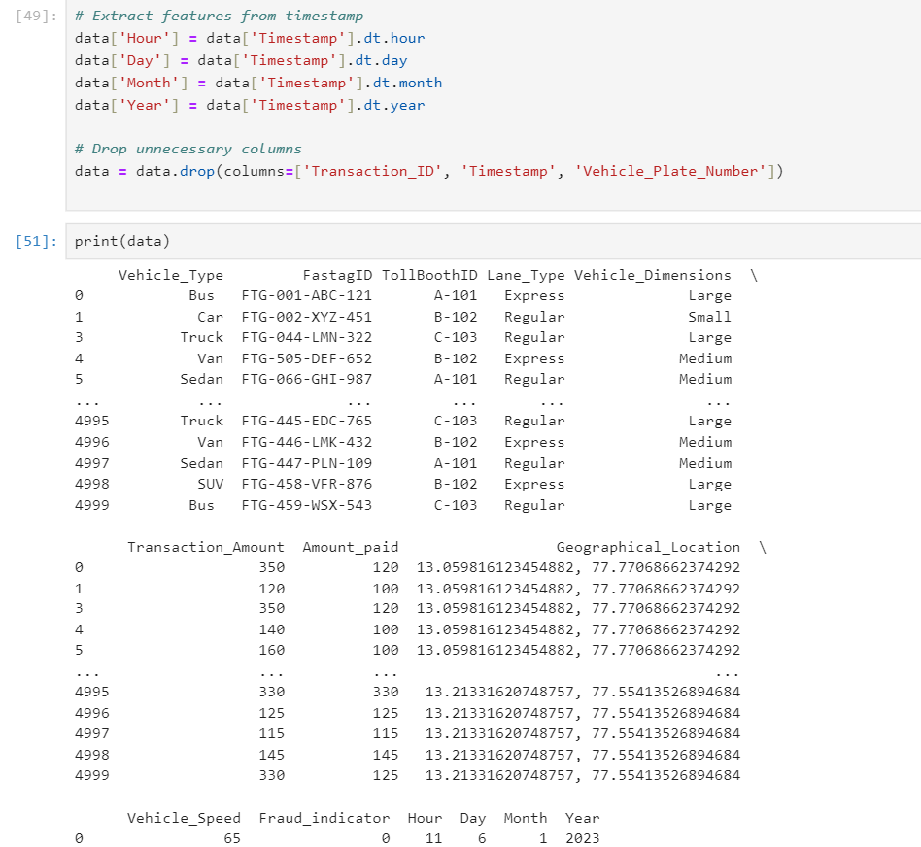
Feature Engineering
Extract features from the timestamp
Drop unnecessary columns

Slide 12
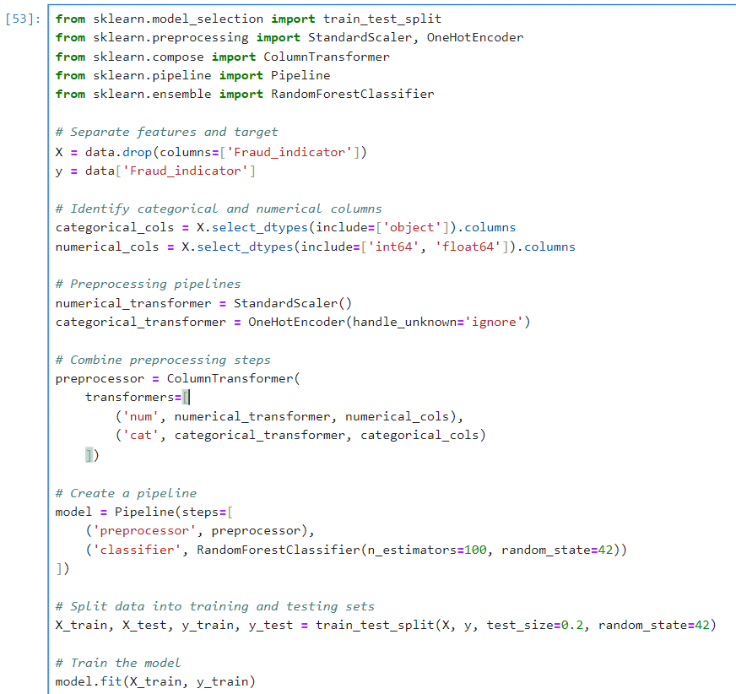
Model Development and Training
Separate features and target
Preprocessing pipelines for numerical and categorical data
Train a RandomForestClassifier

Slide 13
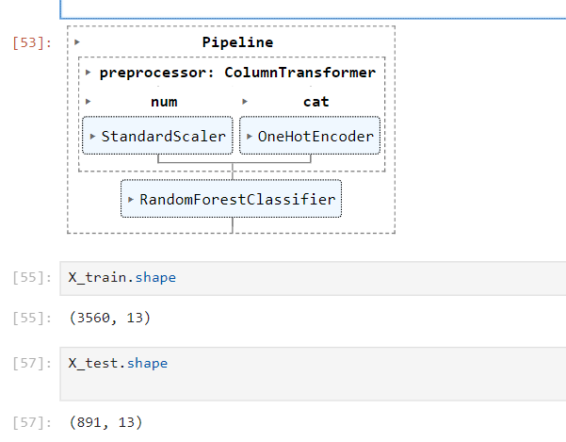

Slide 14
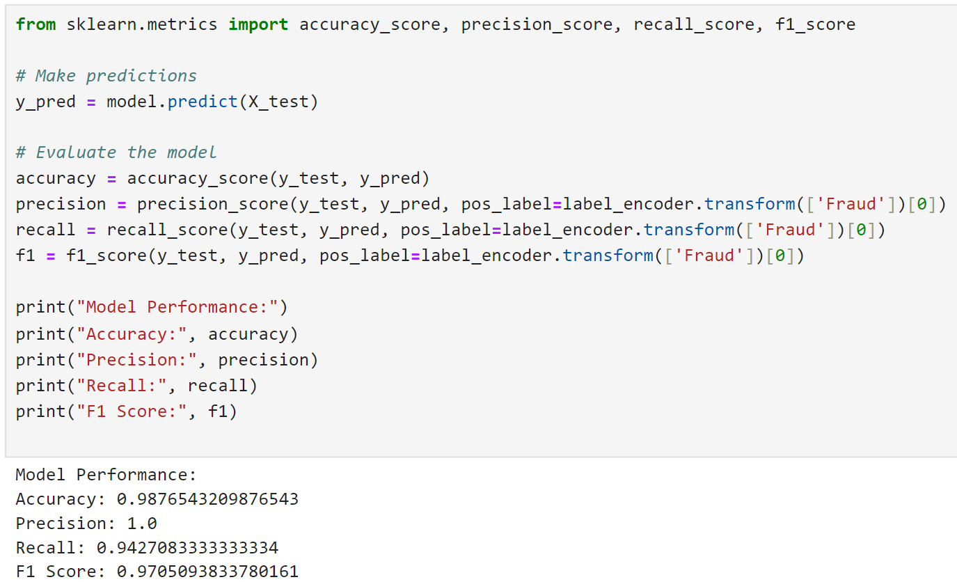
Model Evaluation
Evaluate the model using accuracy, precision, recall, and F1-score

Slide 15
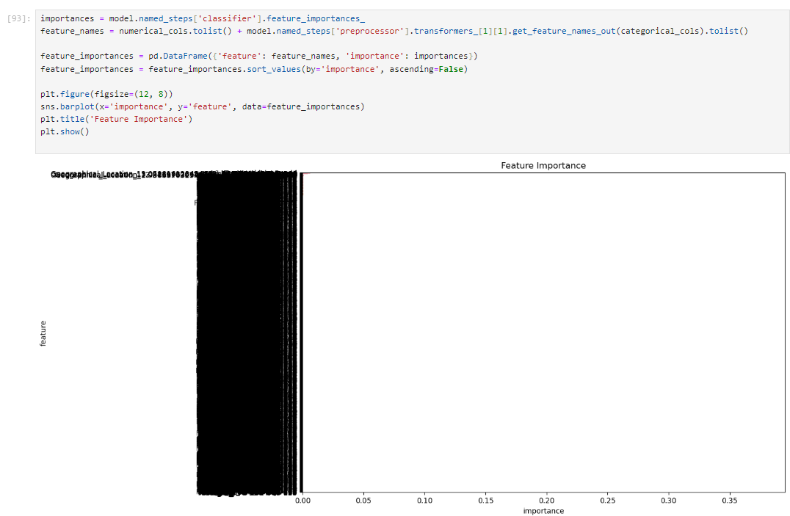
Model Interpretation and Insights
Analyze and interpret the model to understand feature importance and make the model more explainable. Visualize decision boundaries (if applicable)

Slide 16
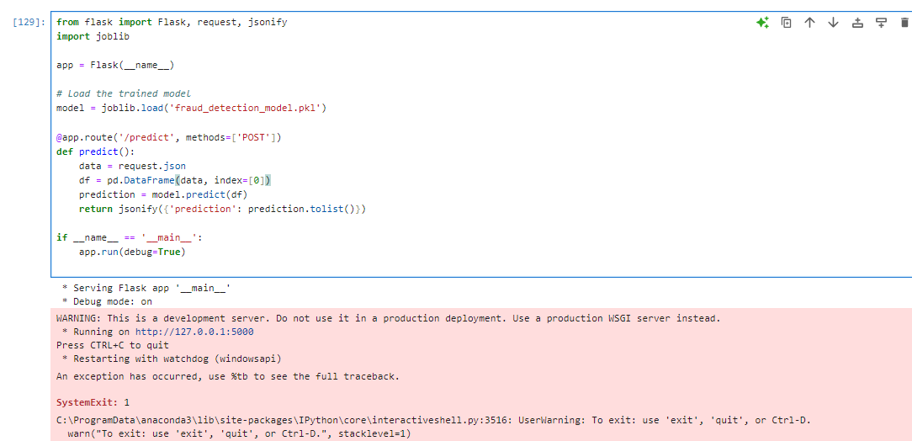
Deployment and Real-time Detection
Deploy the trained model in a production environment using Flask or FastAPI for real-time fraud detection.

Slide 17
Real-time Fraud Detection
Model Deployment:
Use frameworks like Flask or FastAPI to deploy the trained model as a web service.
Host the model on a cloud platform (e.g., AWS, Google Cloud) for scalability and accessibility.
Integration with Fastag System:
Collaborate with the Fastag system developers to integrate the deployed model seamlessly into the transaction processing pipeline.
Ensure compatibility and data exchange capabilities between the Fastag system and the deployed model.
Data Streaming:
Set up data streaming mechanisms (e.g., Kafka, AWS Kinesis) to feed real-time transaction data to the deployed model.
Implement batch processing or stream processing depending on the volume and velocity of transaction data.
Response Mechanism:
Define protocols for handling identified fraudulent transactions, including alert thresholds and response actions.
Develop automated processes or workflows to mitigate the impact of fraudulent activities in real-time.

Slide 18
Performance Monitoring:
Implement logging and monitoring systems to track the performance of the real-time fraud detection system.
Monitor key metrics such as prediction accuracy, response time, and system uptime to ensure effective fraud detection.
Explanatory Analysis
Feature Importance Analysis: Conduct feature importance analysis to identify which features have the most significant impact on predicting fraudulent transactions.
Visualization of Key Features: Visualize key features and their distributions for both fraudulent and non-fraudulent transactions to understand their patterns and differences.
Correlation Analysis: Explore correlations between features and the target variable (fraud indicator) to identify potential relationships and dependencies.
Anomaly Detection: Implement anomaly detection techniques to identify unusual patterns or outliers in the data that may indicate fraudulent behavior.
Temporal Analysis: Analyze temporal patterns of fraudulent transactions over time to identify any recurring trends or seasonal variations.

Slide 19
Conclusion
In conclusion, this internship project successfully developed a robust machine learning-based fraud detection system for Fastag transactions by leveraging a comprehensive dataset encompassing transaction details, vehicle information, geographical location, and transaction amounts.
The project entailed meticulous data preparation, feature engineering, model development, and evaluation, culminating in a highly accurate model capable of distinguishing fraudulent transactions. The integration of this model into a Flask web application facilitates real-time predictions, thereby significantly enhancing the security and integrity of Fastag transactions and demonstrating the practical efficacy of data-driven approaches in fraud detection.

Slide 20
THANK YOU

